Slide 1
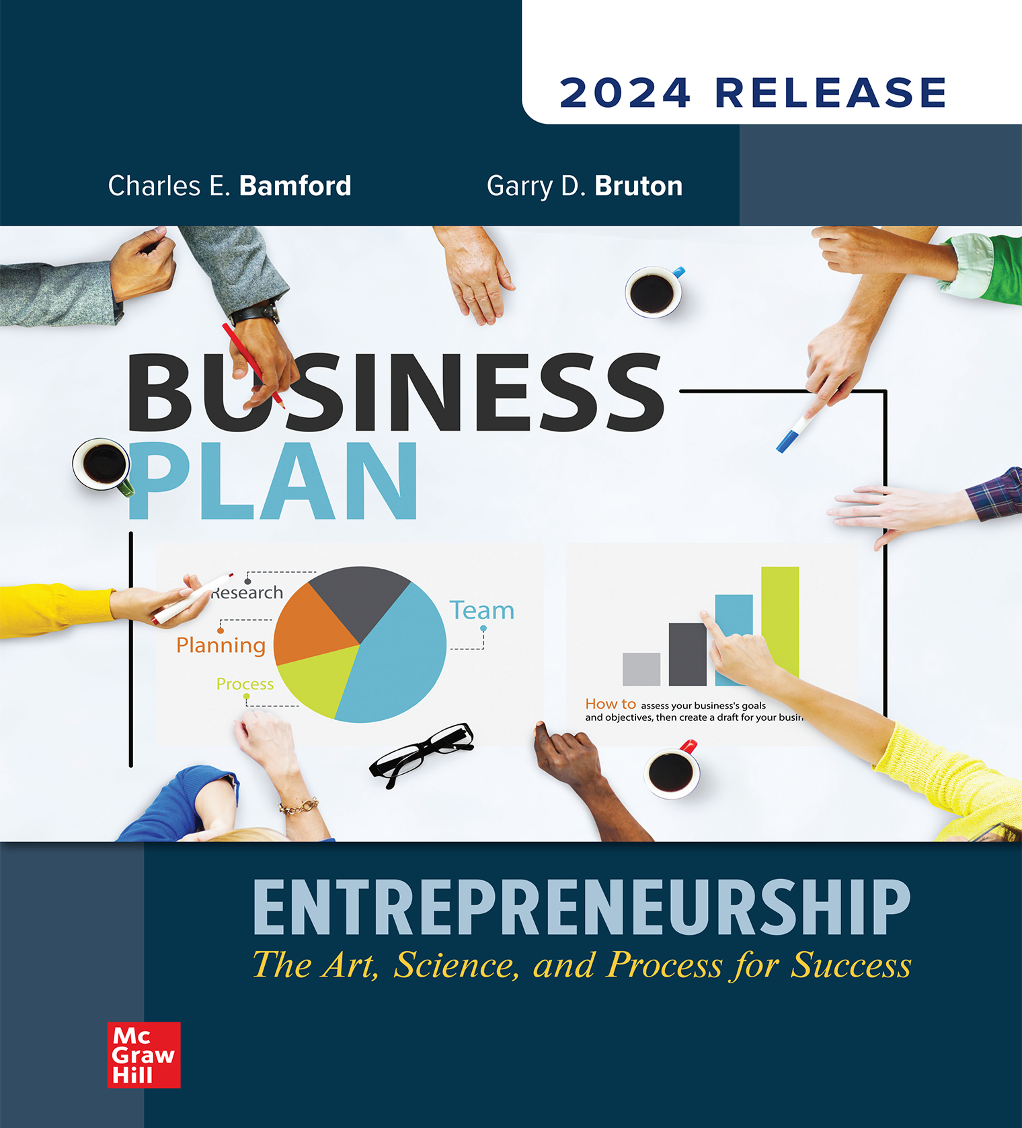
Chapter 12
Establishing Operations
© McGraw Hill LLC. All rights reserved. No reproduction or distribution without the prior written consent of McGraw Hill LLC.
Notes:
Part Four: Building the Business continues with Chapter 12: Establishing Operations.

Slide 2
Use of a Critical Path Chart
Efficient use of time is an absolute imperative for any organization, but especially for a new business.
First operational step for a new business:
Identifying the actions that must occur and in what order will be most efficient.
Notes:
Learning Objective 12-1: Discuss the use of a critical path chart.
The first operations-related concept we want to introduce in this section is also one of the most popular for organizing a wide range of activities in a firm.
An absolute imperative for any organization, but most especially for a new business, is the efficient use of time.
Identifying the actions that must occur and in what order will be most efficient is one of the first operational steps for a new business.
Although it is often not possible to identify every action item that will be required prior to the start of a new business, the effort to develop a complete list will allow the new business to have a faster, more thorough, less expensive start-up.

Slide 3
Critical Path Table
Step | Task | Time to Complete | Actual Time Involved | Previous Task Required | Responsibility
1 | Establish business bank accounts | 1 week | 3 hours | NA | James and Margaret
2 | Obtain bank loan | 2 weeks | 4 hours | NA | James and Margaret
3 | Establish accounting system | 3 weeks | 1 week | NA | Margaret
4 | Lease Facility | 2 weeks | 20 hours | 2 | James and Margaret
The following content is arranged like a table.
Notes:
Learning Objective 12-1: Discuss the use of a critical path chart.
Although there are numerous methods and formats for completing a critical path analysis, the authors present a relatively common, easily understood format that they have used with a number of new start-ups.
Initially, the entrepreneur must identify the most likely amount of time it will take for each of the key tasks to be completed, the actual time one of the owners will be involved, any prerequisite tasks, and who is responsible for the task.
The chart of critical activities might look something like the one in Table 12.1 for a small manufacturer.
It should be noted that while the authors have specified the tasks for a manufacturer, the tasks will be different for different types of businesses.

Slide 4
Critical Path Table
Step | Task | Time to Complete | Actual Time Involved | Previous Task Required | Responsibility
5 | Obtain equipment (office and manufacturing) | 4 weeks | 8 hours | 2 and 4 | James (manufacturing) and Margaret (office)
6 | Acquire raw materials | 4 weeks | 30 hours | 2 and 4 | James
7 | Make initial sales calls | 8 weeks | 90 hours | 2 and 4 | James and Margaret
8 | Produce initial inventory | 4 weeks | 150 hours | 4, 5, 6, and 7 | James and Margaret
The following content is arranged like a table.
Notes:
Learning Objective 12-1: Discuss the use of a critical path chart.
Note that the assigning of responsibilities and estimated times is more than an intellectual activity.
When you specify who will do a task and how long it will take to be completed, you set for yourself a control mechanism to ensure that you are going to be ready when you intend to open.
Underestimating the amount of time it will take to begin operations is a mistake that harms many new businesses.
You should estimate the times very generously, since many critical steps may take significantly longer than originally planned.

Slide 5
Critical Path Chart
Demonstrates how the activities necessary to start the firm fit together and build on each other.
Allows one to understand which activities can occur concurrently and which must already be in place before the next activity can occur.
Notes:
Learning Objective 12-1: Discuss the use of a critical path chart.
Critical path chart is a chart that demonstrates how the activities necessary to start the firm fit together and build on each other. This chart allows you to understand which activities can occur concurrently and which must already be in place before the next activity can occur.

Slide 6
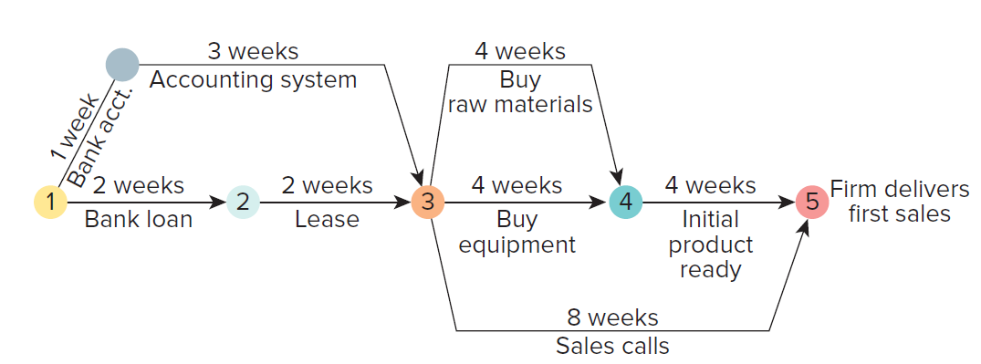
Critical Path Chart
Notes:
Learning Objective 12-1: Discuss the use of a critical path chart.
From the list of critical tasks identified in Table 12.1, the new business can then develop a chart that demonstrates how the activities fit together.
This is your critical path chart that shows the set of activities that are dependent on each other and that take the longest time.
The chart listing the critical tasks provided in Table 12.1 will produce the critical path chart shown in Figure 12.1.
As you can see from the critical path in Figure 12.1, it will take a minimum of 12 weeks to open the business in this case.
The businessperson can make the critical path as detailed as is necessary.
The chart for the small manufacturing firm in Figure 12.1 is actually quite simple.
The new businessperson should be guided by developing a chart that provides the most assistance and information.
For complex start-up operations, there are several project management software packages that will assist you in developing a task chart and producing a critical path chart.
The process for an Internet-based business is somewhat simpler than for a manufacturing business.
However, there are critical steps that can delay the start of any business such as obtaining the required licenses.

Slide 7
Critical Path Templates
Managing Tasks & Milestones
Critical Path Tools
Gantt Charts
Can be used to organize operational processes and business rollout

Slide 8
Critical Path Chart – Operational Charts
Entrepreneurs should:
Constantly update their critical path analysis.
  Chart is continually updated as tasks are accomplished, delayed, added, or changed.
Share the critical path analysis with potential suppliers, friends, and industry experts.
Notes:
Learning Objective 12-1: Discuss the use of a critical path chart.
Entrepreneurs should constantly update their critical path analysis as they develop the plan for a business.
Entrepreneurs should also share that critical path analysis with potential suppliers, friends, and industry experts—with anyone who will look it over for them and add, modify, or delete activities.
The critical path analysis is a living document that should be modified during the process of actually accomplishing the tasks.
As tasks are accomplished, delayed, added, or changed, the chart is continually updated.

Slide 9
Important Issues in the Financing Considerations of New Firms
  New organizations should be able to make initial payments for:
  Security deposits
  Utility setup fees
  Purchase or lease and installation of initial equipment
  All licenses and inspections
  All initial supplies (an often overlooked expense)
  Hiring and training of initial staff
  Initial advertising expenses
  Bank setup fees
Notes:
Learning Objective 12-3: Discuss the important issues in the financing considerations of new firms.
While not addressing the details of financing operations here (those issues were covered in-depth earlier), there is still a gamut of financial issues related to the operational start-up of a new business.
Financing the initial operations begins with the variety of initial payments and the process of setting up the business and ends with the first completed sale.
The new organization has to be in a position to make initial payments for:
Security deposits
Utility setup fees
Purchase or lease and initial equipment of installation
All licenses and inspections
All initial supplies—a significant and often overlooked expense
Hiring and training of initial staff
Initial advertising expenses
Bank setup fees
These costs can be substantial, and the new business must ensure that it has the proper resources to conduct such activities.
Recalling our critical path analysis, if one element, such as purchasing some key inputs, must be delayed because of a lack of resources, the impact can be to place the entire new business’s operations behind schedule.

Slide 10
Establishing a Bank Relationship
Key issues for a new business:
Establishing a revolving line of credit or working capital.
Acquiring a business credit card account.
Setting up a basic business checking account.
Business accounts require a primary signatory and a confirmation signatory as an audit safety condition.
Picking which bank to work with is more than choosing the closest bank.
Notes:
Learning Objective 12-3: Discuss the important issues in the financing considerations of new firms.
It was highlighted earlier that the issue of establishing a bank relationship is critical.
The new business is well served to establish a variety of financial relationships with its bank.
Some of these key issues include establishing a revolving line of credit (working capital), acquiring a business credit card account, and setting up a basic business checking account.
These accounts should have a primary signatory and a confirmation signatory as an audit safety condition.
Using confirmatory signatures ensures both parties know where major expenses occur and that the bill is accurate.
Picking which bank to work with is more than a choice of which branch is closest to you.
Working with small businesses is a specialized skill that all banks will say they possess but that, in fact, may be very limited at a given institution.
If you have a small retail firm, you may need large draws on your lines of credit to get the Christmas merchandise onto your shelves.
If you are a small oil and gas exploration firm you will have other specialized needs, such as determining the value of given leases that you include in your assets.
Whether your bank can work with such issues is an important question for a new business owner.
The expertise of other successful entrepreneurs in your area provides valuable insight into these issues.

Slide 11
Legitimacy
Acceptance by key stakeholders, such as customers and suppliers, that you are a genuine business that will still be in operation next year.
Critical to the long-term survival of the business.
Notes:
Learning Objective 12-4: Distinguish between the various methods with which a new firm establishes legitimacy in the market.
A topic rarely discussed in the establishment of a new business is the issue of legitimacy.
Legitimacy is the term we use to discuss acceptance by key stakeholders, such as customers and suppliers, who believe the firm is a genuine business that will still be in operation next year.
Developing the perception of legitimacy with both customers and suppliers can be difficult, although it is critical to the long-term survival of the business.
Both customers and suppliers want to ensure your business will be operating for the long term before they do business with you.

Slide 12
Methods of Establishing Legitimacy
Business checking account
Business credit card
Bank line of credit
Professional business cards
Professional letterhead, billing slips, envelopes, etc.
Professional advertising material
Prestige of the business address
Job titles
Telephone answering support
High-quality Web page
Board of advisors and/or directors
Endorsements
Notes:
Learning Objective 12-4: Distinguish between the various methods with which a new firm establishes legitimacy in the market.
Regardless of the business location, the entrepreneur needs to consider the potential means with which to establish the legitimacy of the business in the eyes of the customers and suppliers.
Here is a list of classic items that may help establish more legitimacy for your new business:
A business checking account with the firm’s name printed on the checks; start the check numbering higher than 001 or even 101.
A business credit card
A bank line of credit
Professional business cards
Professional letterhead, billing slips, envelopes, and so on
Professional advertising material
The prestige of the business address
Job titles—titles cost you very little, use them liberally
Telephone answering support
A high-quality Web page
A board of advisors and/or directors with excellent community visibility
Endorsements from well-recognized and respected individuals
You may have noticed that some items in the list are quite inexpensive whereas others are both time consuming and expensive.
The authors suggest that all new businesses develop a plan to establish and continually enhance their legitimacy.
While you may not choose to do them all, and appearances are not everything, the business’s legitimacy is critical at the outset of the business.
Thus, every reasonable way to improve the firm’s legitimacy should be taken.

Slide 13
Production Management System
Defines the steps that are involved in moving from the product or service offering to the point where money is received.
It is important to emphasize that all businesses have production systems whether or not they are codified.
Can be put together for the most common and expected routines.
Most important elements: Production charting and quality.
Notes:
Learning Objective 12-5: Explain the importance of production management in start-up ventures.
Another important element in the success of a new business is the establishment of a production management system.
A production management system defines the steps involved in moving your product or service offering to the point where you actually receive money.
The text supplies an example of a start-up that refurbished inkjet printer cartridges. It quickly became apparent that their practice of handling each cartridge on an individual basis did not match their work projections of handling 10,000 cartridges a month.
The firm hired a mechanical engineer who developed a very simple set of procedures with fixed equipment to handle the most common types of cartridges. The production system developed after opening the business was expensive and resulted in many lost opportunities.
Over the next eight months, the company developed a production management system and methodology that allowed them to dramatically cut costs.
It is important to emphasize that all businesses have production systems whether or not they are codified.
All service and Internet businesses have preferred ways of dealing with factors such as customers, paperwork, orders, and services.
These constitute the foundation of a production system.
Putting together a production management system to handle the most common and expected routines will ensure consistent handling and enable the employees to focus their energy on the other, unusual aspects of the job.
While this topic is quite complex and is its own field of study, the authors discuss the two most important elements to production management as they relate to entrepreneurial business.
These are production charting and quality.

Slide 14
Production Chart
Provides a detailed understanding of a firm’s production process.
Details each step that must occur in the production process:
Starts with the order being received.
Finishes with the final delivery to the customer.
Some steps can occur simultaneously while others must occur concurrently.
Notes:
Learning Objective 12-6: Explain how production charting is accomplished.
A production chart is a chart that provides a detailed understanding of a firm’s production process.
To emphasize the importance of such production charting, entrepreneurs need only look to franchises.
One of the reasons that franchises are so successful is that they have well established methods of operation.
The franchisors have prepared these methods for the franchisees in a plan detailing each step that occurs in the production process and when each step is to occur.
This type of exercise is enormously helpful for all new entrepreneurial businesses.
This level of detailed understanding about a firm’s production typically comes from a production chart.
You will recall that at the beginning of this chapter, we discussed a critical path chart.
A production chart is similar; however, rather than focusing on the founding of the business, this chart details each step that must occur in the production process.
It takes the reader step by step through the processes necessary to provide the customer with the finished product.
It starts with the order being received and finishes with the final delivery to the customer.
The production chart is similar to the critical path chart in that some steps in the production process can occur simultaneously while others must occur concurrently.

Slide 15
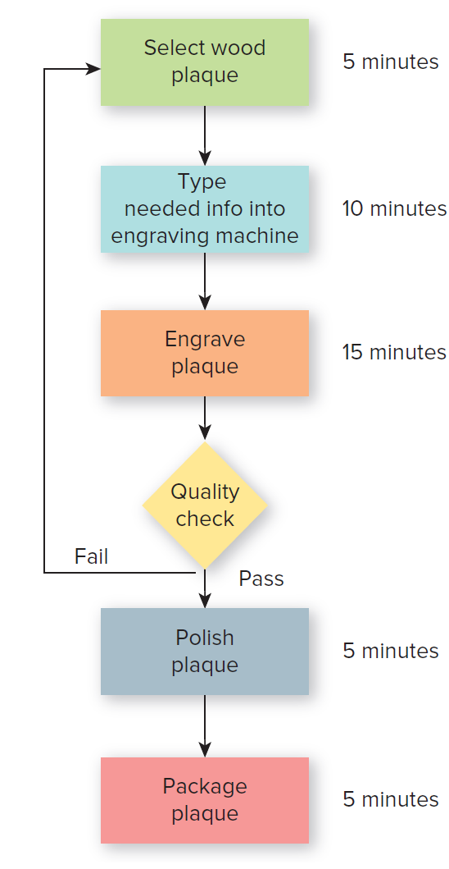
Production Chart
Notes:
Learning Objective 12-6: Explain how production charting is accomplished.
The authors have chosen a slightly different format from the traditional one used in most textbooks.
Most textbooks focus on established company production processes and have many items occurring concurrently; however, the authors have found that new firms have limited personnel and the processes are more sequential.
The process detailed in the production chart in Figure 12.2 is very simple: production of a plaque from a trophy shop.
Even for early-stage ventures, the production chart can become complex quite quickly.
Imagine the difficulty in producing meals from a menu that may have 25 different entrées with different vegetable selections.
There are many established production management systems that operate on any computer available to new business owners.
If you are starting a business that is part of an established industry, then you should talk to others in the industry regarding the popular packages for the management of your business processes.
Starting one from scratch is a waste of time and money. A little effort investigating the industry should provide tremendous positives for the organization.

Slide 16
Importance of Quality as a Competitive Tool
Quality is an assumed standard.
Founders need to put monitoring and measuring systems into place to successfully deliver quality.
Deming: Father of the quality movement, who suggests that:
(TQM, Kaizen, ISO, Six Sigma)
Quality must be improved constantly and consistently.
Goals for quality must be set.
Scientific method should be used when making changes.
Quality of inputs, which affects outputs, should be the focus.
Notes:
Learning Objective 12-7: Describe the importance of quality as a competitive tool.
Another important consideration in all aspects of a business venture is the investment in quality.
Increasingly, however, quality is an assumed standard whether the entrepreneurial business is in manufacturing or is a service business.
New businesses need to be clear about the expectations for quality in whatever business they pursue.
One of the keys to successfully delivering quality is the monitoring and measuring systems put into place by the founders.
Dr. W. Edwards Deming is considered the father of the quality movement in the United States.
One of his arguments is that quality needs to be constantly and consistently improved. Thus, there needs to be a continuous set of measures for each of the various processes of the organization.
Deming went much further and argued that while the organization should set goals for quality in the organization, these goals are not to drive every action.
If a firm focuses only on those goals, the firm might make short-term decisions that were detrimental to the overall direction of the company.
Deming strongly suggests that the firm be guided by what he calls the “scientific method.” In this method, rather than changing lots of things at the same time, the firm should change only one thing at a time, measuring the impact of that change.
Additionally, Deming suggests that rather than focusing strictly on obtaining the lowest prices for supplies, firms should focus on the quality of the inputs. He argues that without quality inputs, the output has no chance to be high quality.

Slide 17
Strategic Alliances
Firms joining together to form long-term, mutually beneficial relationships.
Notes:
Learning Objective 12-7: Describe the importance of quality as a competitive tool.
Some firms focus on forming strategic alliances, where firms join together to form long-term, mutually beneficial relationships.
Firms, both large and small, then seek to establish a reasonable price for their inputs and then seek a long-term relationship with a supplier that can meet that price and supply a consistent, high-quality product.
A consistent input helps the firm produce a consistent output.

Slide 18
Type and Condition of Equipment Needed at Start-Up
Acquiring initial equipment can be daunting and one of the most expensive tasks:
Purchasing new equipment is expensive, and delivery may be delayed.
Purchasing used equipment has risks but should be investigated.
Leasing has low initial costs but high long-term costs.
Clear understanding of what equipment is needed, both now and in the future, is a must.
New business owner should prepare a chart comparing the price and the positives and negatives of buying new, buying used, or leasing equipment.
Notes:
Learning Objective 12-8: Discuss the type and condition of equipment needed at start-up.
Acquiring the initial equipment for a business can be a daunting task. The basic equipment can easily be one of the most expensive elements for a new business.
Businesses with even greater equipment needs, such as a restaurant, need to accurately evaluate the equipment needs while at the same time recognize that there is a wide flexibility in the types, ages, methods of acquisition, and availability of all equipment obtained for the new organization.
Purchasing new equipment may guarantee that it is the most current available and that it will be delivered directly to the new business; however, it is usually the most expensive method, and delays may be significant if the items are not in stock.
Purchasing older equipment has its own risks with quality and availability but should always be investigated.
It is relatively common for new equipment to depreciate 50 percent or more in the first year.
Similarly, it is possible to lease equipment.
The ability to lease the equipment is particularly attractive to new firms as it has the lowest initial costs. However, over the long run, such leasing can prove expensive.
Therefore, the new business owner needs to clearly understand what equipment is needed, how long it will be before it will need to be replaced, and what are the long-term impacts of the decision.
This understanding should also include both what equipment is needed to begin operations and how quickly the company might need more or even bigger equipment.
The new business owner should then prepare a chart comparing the price and the positives and negatives of buying new, buying used, or leasing equipment.
The positives and negatives should include not only the immediate cost and the ability to overcome the cash flow crunch that impacts all new businesses but also the impact on the firm’s quality and the long-term impact if the entrepreneurial business grows.

